Slide 1
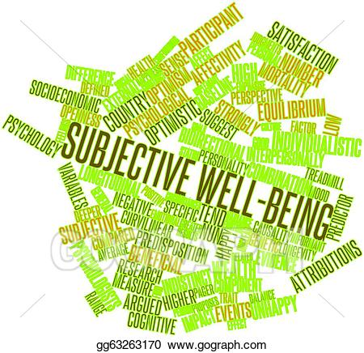
Chapter 3

Slide 2

“Happiness is not a goal. It’s a by-product of a life well lived” Eleanor Roosevelt

Slide 3
The Measurement of Subjective Well-Being
How happy are you?
Evaluations of happiness are subjective phenomena
3 Facets of Subjective Well-Being
Happiness
Life satisfaction
Neuroticism (low)

Slide 4
The Measurement of Subjective Well-Being
Self-Report Measures of Subjective Well-Being
Scales used to measure happiness
Satisfaction with Life Scale
Subjective Happiness Scale
Notes:
In most ways ideal life 1–8 scale: The amount of happiness or satisfaction that a person experiences can be meaningfully translated into a numerical scale. Two people both scored an 8 on the same test, then they both had approximately the same level of happiness.

Slide 5
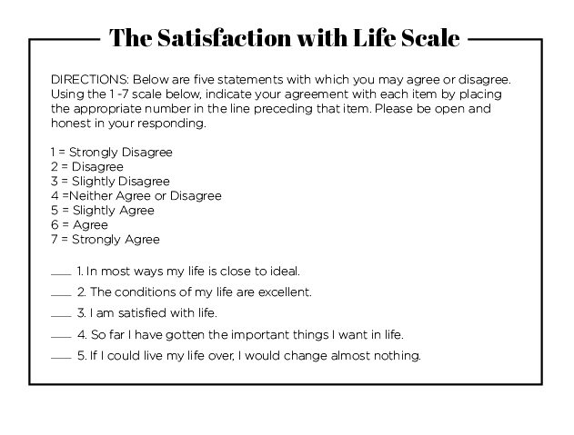

Slide 6
The Measurement of Subjective Well-Being
The Stability of Subjective Well-Being
Relatively stable
Life events and daily fluctuations impact subjective well-being
Self-report measures

Slide 7
The Measurement of Subjective Well-Being
Why Is Happiness Important?
Beneffectance
Most people view self as beneficial and effective
Happier people are successful
Better marriages
More fulfilling friendships and social relationships
Healthier
More involved in their communities
Better coping skills
More satisfied with their jobs
Higher incomes
Notes:
Beneffectance: Describes how most people view themselves--that is, as beneficial and effective.

Slide 8
The Measurement of Subjective Well-Being
Why Is Happiness Important?
Higher subjective well-being connects to having a better life
e.g., positive emotions may help students learn more effectively; reduce racial bias
Being happier help people lead to more satisfying lives
Notes:
Beneffectance: Describes how most people view themselves--that is, as beneficial and effective.

Slide 9
The Measurement of Subjective Well-Being
Top-Down and Bottom-Up Theories
Top-down theory
Bringing our tendencies toward positive interpretations to situations we encounter in life
i.e., bring knowledge, experience to situations
e.g., change of season…interpret as positive because think of apples, cider, cider donuts
Supports certain attitudes, self-perceptions, and personality traits are highly correlated with subjective well-being
Notes:
Top-down theory: Supports certain attitudes, self-perceptions, and personality traits are highly correlated with subjective well-being.
Bottom-up theory: Supports that poverty is associated with lower levels of subjective well-being and that certain negative life events can have a lasting impact on happiness.

Slide 10
The Measurement of Subjective Well-Being
Top-Down and Bottom-Up Theories
Bottom-up theory
Characteristics of the situation used to assess SWB
Supports that poverty is associated with lower levels of subjective well-being and that certain negative life events can have a lasting impact on happiness
Assessing quality of marriage and several other areas to create statement of overall satisfaction
Both Top-Down and Bottom-Up important and used in different situations and times in life
Notes:
Top-down theory: Supports certain attitudes, self-perceptions, and personality traits are highly correlated with subjective well-being.
Bottom-up theory: Supports that poverty is associated with lower levels of subjective well-being and that certain negative life events can have a lasting impact on happiness.

Slide 11
Top-Down Predictors of Subjective Well-Being
Cognition: Is the Glass Half Full? Half Empty?
Happier and satisfied people view world in positive ways…how we interpret events
Construals: freely chosen interpretations of reality
Positive mood seems to lead us to interpret events in positive ways
May pay attention and process information consistent with our mood
e.g., walk into crowded airport waiting area…happier people will “see” smiling couples and doting parents, unhappy people will “see” people who are tense, impatient

Slide 12

Happiness is a choice

Slide 13
Top-Down Predictors of Subjective Well-Being
Cognition: Self-Esteem
Positive self-esteem works against negative emotions
High self-esteem leads to increased happiness (well, positive self-esteem and happiness are highly correlated)

Slide 14
Top-Down Predictors of Subjective Well-Being
Cognition: Self-Esteem
High self-esteem is composed of at least four components
Feeling that one is accepted by others
Being the recipient of positive evals by others
Believe that one compares favorably to other people or to one’s ideal self
Believing that one can initiate effective action in the world

Slide 15
Top-Down Predictors of Subjective Well-Being
Cognition: Self-Esteem
Self-esteem as predictor of WB is tricky
Self-esteem is related more to optimism and achievement, happiness related to positive social relationships and extraversion
Positive self-esteem may be more useful for defending against negative emotions than for promoting happiness
Note: self-esteem valued more in US

Slide 16
Top-Down Predictors of Subjective Well-Being
Cognition: Optimism and Hope
Optimists
More effective coping behavior
Problem-focused coping, humor, positive reframing
Better physical health
Experience better relationships with others
Greater self-confidence and perseverance with challenges
Notes:
Dispositional optimism: The global expectation that events will turn out well in the future.
Explanatory style: People interpret the causes of past events in their lives.

Slide 17
Top-Down Predictors of Subjective Well-Being
Cognition: Optimism and Hope
Presence of positive expectancies
Optimism conceptualized as:
Dispositional optimism
global expectation that events will turn out well
Explanatory style
Way in which we interpret causes of events
Notes:
Dispositional optimism: The global expectation that events will turn out well in the future.
Explanatory style: People interpret the causes of past events in their lives.

Slide 18
Top-Down Predictors of Subjective Well-Being
Cognition: Optimism and Hope
Learned Optimism (Seligman)
Optimists more willing to receive negative feedback about their performance, absorb bad news about their health, to raise difficult issues in their personal relationships
Realistic Optimism (S. Schneider)
Optimistic thinking that does not distort reality
Notes:
Dispositional optimism: The global expectation that events will turn out well in the future.
Explanatory style: People interpret the causes of past events in their lives.

Slide 19
Top-Down Predictors of Subjective Well-Being
Cognition: Optimism and Hope
Hope has two components:
Pathways
Ability to find ways to reach one’s goals
Agency
Motivation to reach these goals
Hope is the belief that one can find pathways to achieve desired goals and the belief that desired goals can be attained
Notes:
Pathways: The ability to find ways to reach one’s goals.
Agency: Motivation to reach these goals.

Slide 20
Top-Down Predictors of Subjective Well-Being
Cognition: Sense of Control
Sense for desired outcomes and avoid undesirable ones
Internal locus of control
External locus of control
Maintaining emotional stability and negotiate difficulties in life

Slide 21
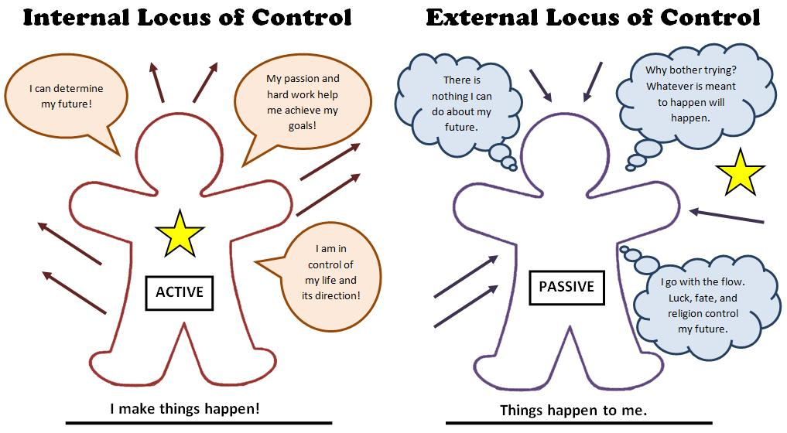

Slide 22

Top-Down Predictors of Subjective Well-Being
Cognition: Self-Efficacy
Self-efficacy: Belief that one has the capabilities to produce desired effects by their own actions
Related higher to well-being throughout the life span
Measured in relationship to specific outcomes

Slide 23
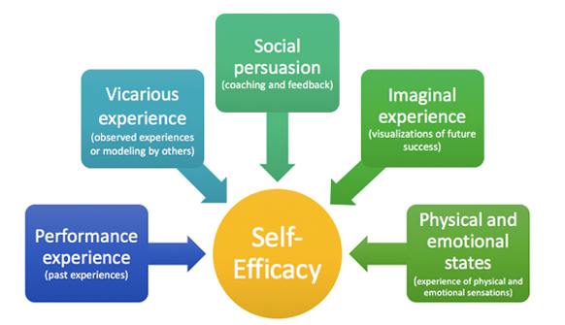
Top-Down Predictors of Subjective Well-Being
Cognition: Self-Efficacy

Slide 24

Self-Efficacy and Cognitive Reframing
Jim Cirillo, NYPD firearms instructor, involved in a number of gunfights
Trained himself with positive imagery to clear his mind of any self-doubting conscious thoughts
“If you jerk the trigger, you will miss the target” became “As you focus on the sights while compressing the trigger smoothly, you will achieve a good shot”

Slide 25


A little encouragement
Cyldesdale Dream Baby

Slide 26
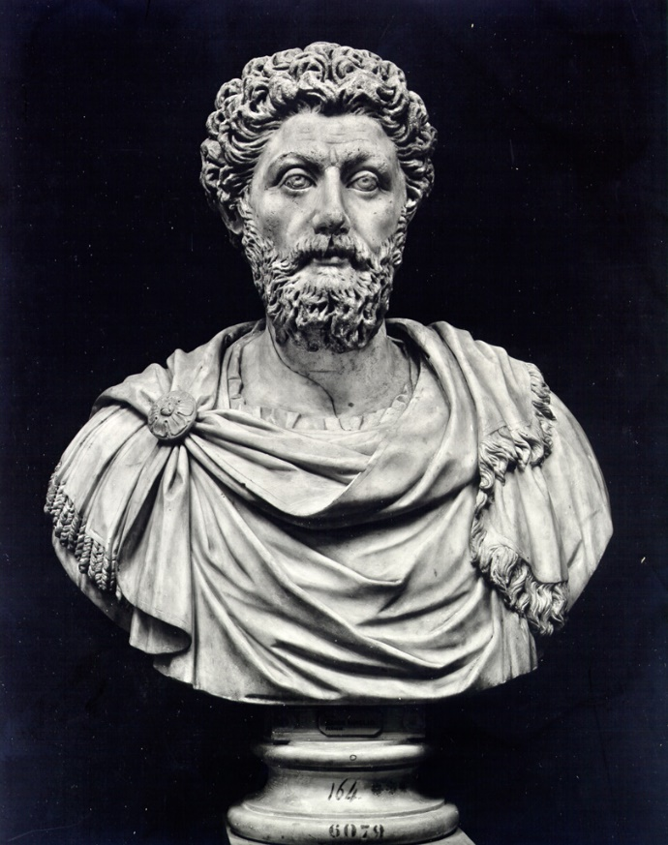
Role Modeling/Vicarious Learning
“Take a good look at people’s ruling principle, especially of the wise, what they run away from and what they seek out.”
– Marcus Aurelius

Slide 27


Slide 28
Top-Down Predictors of Subjective Well-Being
Cognition: A Sense of Meaning in Life
Predictor of higher subjective well-being
Greater sense of meaning in life increases
well-being at all stages of life
Greater openness and experiences
Need not be tied to religious beliefs…just needs to be personally meaningful

Slide 29
Top-Down Predictors of Subjective Well-Being
Cognition: Decision-Making and Self-Reflection
Happier people:
Report more satisfaction when making decisions
Ruminate less
Prefer to experience pleasant event quickly after unpleasant event
Self-reflection allows thoughts to wander or to daydream

Slide 30
Top-Down Predictors of Subjective Well-Being
Positive Relationships With Other People
Supportive social support/relationships
Higher self-esteem, successful coping, better physical health, fewer psychological challenges
Intimate social relationships (spouse, family, best friends) tend to be strongest predictors of life satisfaction
Companionship and self-validation
Notes:
Good social support: Enhanced effects on subjective well-being from positive self-esteem, optimism, and perceived control. Intimate social relationships provide even greater enhancements of subjective well-being.
Companionship and self-validation: The strongest components of quality relationships.

Slide 31
Top-Down Predictors of Subjective Well-Being
Positive Relationships With Other People
Social connection can be contagious
Challenge:
Deliberately make contact with another person (e.g., someone on the bus, seated next to you, walking the same way as you)
If at a loss for words, say “Hi, I’m taking this class called Positive Psychology and my professor asked us to start conversations with people who look friendly, and I choose you.”
Notes:
Good social support: Enhanced effects on subjective well-being from positive self-esteem, optimism, and perceived control. Intimate social relationships provide even greater enhancements of subjective well-being.
Companionship and self-validation: The strongest components of quality relationships.

Slide 32
Top-Down Predictors of Subjective Well-Being
Personality Traits
Relationship between genetically influenced traits and well-being
Traits associated with well-being
Extraversion
Agreeableness
Conscientiousness
Neuroticism

Slide 33
Top-Down Predictors of Subjective Well-Being
Personality Traits: Extraversion
Maintain positive relations with other people
Direct positive impact on well-being
High self-reported happiness
Greater sensitivity to positive rewards
Why do extroverts report more happiness: They have a cheerful disposition

Slide 34
Top-Down Predictors of Subjective Well-Being
Personality Traits: Agreeableness and Conscientiousness
Agreeableness: Being honest, trustworthy, modest, compliant, tender-minded, and altruistic
People high in conscientiousness are self-disciplined, achievement striving, wilful, dutiful, and competent

Slide 35
Top-Down Predictors of Subjective Well-Being
Personality Traits: Neuroticism
Eliminate neuroticism to increase happiness and life satisfaction
One facet of neuroticism crucial for subjective well-being: depression

Slide 36
Top-Down Predictors of Subjective Well-Being
Personality Traits: Comments on Personality Traits and Well-Being
Different impact on well-being at different ages
Interact with life events
Traits impact well-being and well-being impacts the expression of traits

Slide 37
Bottom-Up Predictors of Subjective Well-Being
Money, Income, and Wealth
Assumption that money brings happiness and satisfaction a persistent message in most societies
GDP-average life satisfaction correlation .50
Lower quarter of income distribution reduces the odds of being happy by about 26%
Upper quarter increases the odds by about 13%
Notes:
Tipping point: Below which money is important to well-being and above which point money is less important.
Satiation points: Or the amount of income needed before well-being no longer raises with income.

Slide 38

Bottom-Up Predictors of Subjective Well-Being
Money, Income, and Wealth
Diminishing marginal utility
Happiness increases more quickly as income goes up only for those who have less income to begin with
Notes:
Tipping point: Below which money is important to well-being and above which point money is less important.
Satiation points: Or the amount of income needed before well-being no longer raises with income.

Slide 39
Bottom-Up Predictors of Subjective Well-Being
Money, Income, and Wealth
Tipping point
Point at which additional income does not impact well-being (U.S. $85,375 in 2017 US$).
Above that point does not raise happiness, but may raise life satisfaction
Below which money is important to well-being and above which point money is less important.
Notes:
Tipping point: Below which money is important to well-being and above which point money is less important.
Satiation points: Or the amount of income needed before well-being no longer raises with income.

Slide 40
Bottom-Up Predictors of Subjective Well-Being
Money, Income, and Wealth
Satiation points
Point at which amount of income needed before well-being no longer raises with income
Gallup World Poll
$95,000 (USD) for life satisfaction (2018
$60,000-$75,000 (USD) for emotional well-being or happiness
Notes:
Tipping point: Below which money is important to well-being and above which point money is less important.
Satiation points: Or the amount of income needed before well-being no longer raises with income.

Slide 41
Bottom-Up Predictors of Subjective Well-Being
Money, Income, and Wealth
Hedonic Treadmill
Keep setting higher goals in hopes of becoming “really happy”
Research suggests those who place a high value on money for personal happiness are less satisfied with their lives than others
Notes:
Tipping point: Below which money is important to well-being and above which point money is less important.
Satiation points: Or the amount of income needed before well-being no longer raises with income.

Slide 42
Bottom-Up Predictors of Subjective Well-Being
Money, Income, and Wealth: How Money Can Increase Subjective Well-Being
Spending $ on “material purchases” or “experiential purposes”
Activities that enhance personal growth
Use it to foster relationships with family and friends
Type of spending indeed increased personal happiness

Slide 43
Bottom-Up Predictors of Subjective Well-Being
Money, Income, and Wealth: How Money Can Increase Subjective Well-Being
Some Takeaways:
Positive attitude tends to be more important to well-being than income
Income is not a sufficient statistic for happiness…there is a complex relationship with many different factors

Slide 44
Bottom-Up Predictors of Subjective Well-Being
Gender: Are Men or Women Happier?
Women’s average happiness has fallen dramatically since 1972
No gender differences in the frequency, intensity or impact of emotions (stereotype that women are more emotional is just not accurate)
Women are happier than men before about age 48
Men are happier than women after midlife

Slide 45
Bottom-Up Predictors of Subjective Well-Being
Gender: Are Men or Women Happier?
Women and men calculate their well-being differently
Women enhance WB through positive self-esteem, greater harmony and closeness in their relationships, passive leisure, and religion
Men enhance WB through positive self-esteem, active leisure, and greater mental control

Slide 46
Bottom-Up Predictors of Subjective Well-Being
Attractiveness, Climate, and Other Predictors
Physical attractiveness is related to well-being for women in urban areas
Climate does have an impact on moods
People living in areas with more clement temperature (i.e., 72°F/22°C) scored higher on personality traits related to sociability, emotional stability, and personal growth
Education does not impact happiness in any significant way
Notes:
Climate does have an impact on moods: People living in areas with more clement temperature (i.e., 72°F/22°C) scored higher on personality traits related to sociability, emotional stability, and personal growth.

Slide 47
Bottom-Up Predictors of Subjective Well-Being
The Impact of Discrimination on Subjective Well-Being
Meta-analysis
Perceived discrimination (race, gender, sexual orientation, HIV+ status, mental illness, physical disability, and obesity) has negative impact on well-being (PA, life satisfaction, self-esteem), and impacted children more severely
Personal target more negative impact than member of a discriminated group
Positive social support an important factor in moderating the impact of discrimination

Slide 48
Bottom-Up Predictors of Subjective Well-Being
The Impact of Discrimination on Subjective Well-Being
Meta-analysis
Positive social support an important factor in moderating the impact of discrimination
Engagement type coping strategies better than disengagement coping
Alter the situation
Alter one’s reaction to the situation

Slide 49
Bottom-Up Predictors of Subjective Well-Being
The Impact of Discrimination on Subjective Well-Being: Race and Subjective Well-Being
Differences between racial groups within a specific culture (this chapter)
Differences among ethnically diverse cultures (in chapter 11)

Slide 50
Bottom-Up Predictors of Subjective Well-Being
The Impact of Discrimination on Subjective Well-Being: Sexual Orientation and Sexual Identity
Discrimination against lesbians, gays, bisexuals, and transsexuals
Related to depression, anger, stress
Multiple sources of discrimination beginning to be researched more
Positive well-being among LGBT people associated with greater social support

Slide 51
Bottom-Up Predictors of Subjective Well-Being
Bottom-Up Predictors and the “Happiest Man in
America”
Bottom-up predictors influence levels of subjective well-being
Gender, income, race, and marital status interact in relatively complex ways throughout the life span to influence levels of subjective well-being
Notes:
Bottom-up predictors influence levels of subjective well-being: Such as gender, income, race, and marital status interact in relatively complex ways throughout the life span to influence levels of subjective well-being.

Slide 52

Bottom-Up Predictors of Subjective Well-Being
Bottom-Up Predictors
The Gallup organization found the happiest man in America, Mr. Alvin Wong
Gallup’s answer: he’s a tall, Asian-American, observant Jew who is at least 65 and married, has children, lives in Hawaii, runs his own business and has a household income of more than $120,000 a year.
Notes:
Bottom-up predictors influence levels of subjective well-being: Such as gender, income, race, and marital status interact in relatively complex ways throughout the life span to influence levels of subjective well-being.

Slide 53
Increasing Happiness and Life Satisfaction
Genetic inheritance does not determine our long-term happiness
Hedonic adaptations
Adapt to a positive stimulus so no longer feel its effects (e.g., hedonic treadmill and income)
But, we can make positive changes
To avoid hedonic treadmill
Speed up adaptation to negative events
Slow down adaptation to positive events
Notes:
Hedonic adaptations: Adaptation of a positive stimulus and no longer feel the effects.
Multiple set points: For example, one for work satisfaction, another for marital satisfaction, and so on, and some set points may be more fluid than others.

Slide 54
Increasing Happiness and Life Satisfaction
Intensity and Frequency of Positive Emotion
Peak-and-end rule
Intense peak moment and last moment of experience impacts how we think about the experience overall
However, frequency is more important than
intensity
Feeling moderate subjective well-being brings more beneficial effect
Large fluctuations in emotions are related to more negative emotions than positive

Slide 55
Increasing Happiness and Life Satisfaction
Strategies for Creating a Good Mood
Self-help strategies are helpful for short period
Doing something that increases the ratio of positive to negative emotions in one’s life

Slide 56
Increasing Happiness and Life Satisfaction
Fordyce’s Happiness Training Program
Fourteen fundamentals of happiness
Change your activities
Change your thinking
Nurture relationships
Value personal growth
Decrease negative emotions
Practice simple meditation technique to increase the happiness scores
Implementing Fordyce's program for happiness
Notes:
Fourteen fundamentals of happiness:
Grouped as--change your activities, change your thinking, nurture relationships, value personal growth, and decrease negative emotions.

Slide 57
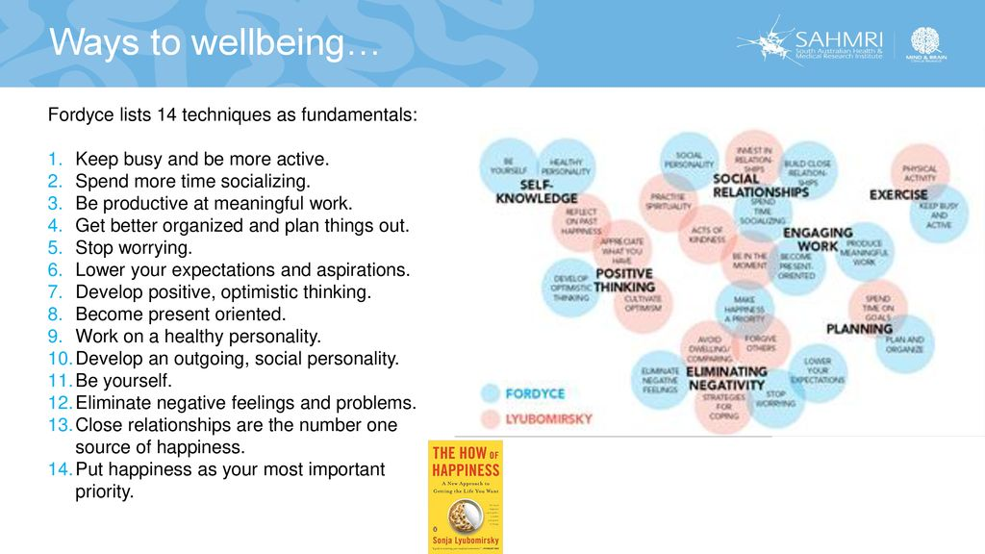

Slide 58
Increasing Happiness and Life Satisfaction
Sustainable Happiness
Long-term happiness is a function of
one’s genetically determined set point
circumstantial factors
intentional activity
Choose goals that interest you
Follow through on strengths

Slide 59
Increasing Happiness and Life Satisfaction
Barbara Fredrickson’s Positivity
Relaxation strategies
Meditations, massages, muscle relaxations
Gratitude journal
Loving-kindness, a unique style of meditation, especially helpful
Mindfulness meditation
People should stop ruminating about issues…healthy distraction helpful
Focus attention on sensory sensations, activities, or helping other people
Notes:
Relaxation strategies: Such as meditations, massages, and muscle relaxations are useful.

Slide 60
Increasing Happiness and Life Satisfaction
Making Interventions More Effective
Therapeutic lifestyle changes: exercise, nutrition, recreation, stress mgt, spiritual involvment
Maintaining a sense of well-being through the ups-and-downs of life is a challenge
To enhance the effectiveness of these interventions is to examine if some actually work better than others

Slide 61
Increasing Happiness and Life Satisfaction
Making Interventions More Effective
Comparing Interventions: Which Ones Work Better?
Seligman etal (2005)
3 things grateful for and why, and VIA and using those strengths increased happiness and decreased depression for 6 months
Gratitude letter…1 month

Slide 62
Increasing Happiness and Life Satisfaction
Making Interventions More Effective
Comparing Interventions: Which Ones Work Better?
To evaluate the effectiveness of four happiness interventions
Express gratitude
Smile more
Recall a pleasant event that happened the previous day * resulted in greatest increase
Perform an act of kindness

Slide 63
Increasing Happiness and Life Satisfaction
Making Interventions More Effective: Moderators of Effectiveness
One of the moderators of effectiveness is motivation
Interventions that are practiced for longer periods of time tend to have a greater impact
People react differently to interventions because of personal traits

Slide 64
Increasing Happiness and Life Satisfaction
General Comments on Increasing Happiness
No one can remain cheerful, jovial, and optimistic most of the time
Feeling relaxed, energized or activated, and safe or content all impacted well-being
Feeling safe resulted in the greatest reduction in depression, anxiety, stress, and self-criticism

Slide 65
Can You Be Too Happy?
Cautionary Tales: The Down Side of Feeling Up
Wanting happiness too much can lead to loneliness
Being happy can make people more gullible
Being in a positive mood may tend to make us more selfish
Unrealistic optimism: creates false sense of security and a bias in risk perception

Slide 66
Can You Be Too Happy?
Cautionary Tales: The Down Side of Feeling Up
Stockdale paradox
Prisoner of war
Said those that perished were the optimists
Believed they would be rescued soon, so they were constantly disappointed
Said not to confuse faith in eventual happy outcome with denial of the reality of one’s current predicament

Slide 67
Can You Be Too Happy?
We Also Need Negative Emotions
Both positive and negative emotions are important to experience a full life
Emodiversity
Greater well-being when people acknowledge both their positive and negative emotions
Greater emotional diversity may help increase resilience and counter our tendency to adapt or habituate to specific positive emotions
Sadness and depression can at times be helpful emotions
Notes:
Emodiversity: That greater well-being when people acknowledge both their positive and negative emotions. Greater emotional diversity may help increase resilience and counter our tendency to adapt or habituate to specific positive emotions.

Slide 68


